Slide 1
Aggregation, Composition and Association
CS1004 Object Oriented Programming

Slide 2
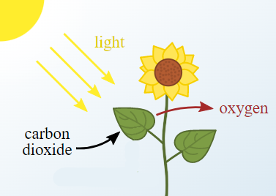

Identifying objects
Entities in the real world consist of attributes and behaviors
One motivation for using OOP was that it represents real world entities better than structured programming
How to identify objects / classes in the real world?
Objects
Car, Body, Steering wheel, tires, engine,
Driver
Objects
Plant, Flower, Leaves,
Sunlight

Slide 3
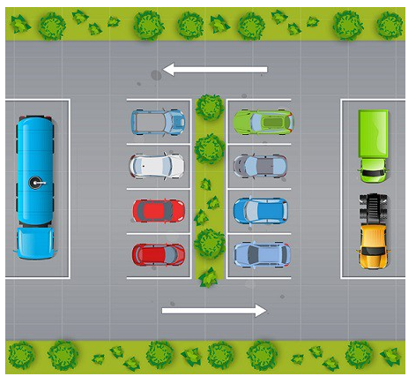
Identifying objects
Case Study (Parking lot)
A parking lot is an open area designated for parking cars. We will design a parking lot where a certain number of cars can be parked for a certain amount of time. Each parking slot can have a single vehicle/car parked in it.

Slide 4
Interaction between objects
Plant Example
Car Example
Leaves interact with the sunlight
Driver interacts with the car
Objects
Car, Body, Steering wheel, tires, engine,
Driver
Objects
Plant, Flower, Leaves,
Sunlight

Slide 5
Relationship b/w objects
Objects in the real world have relationships with each other
When an object has a relationship with another object it can interact with it
What are the relationships between objects?
Understanding these relationships help in writing reusable and extensible code - HOW?

Slide 6
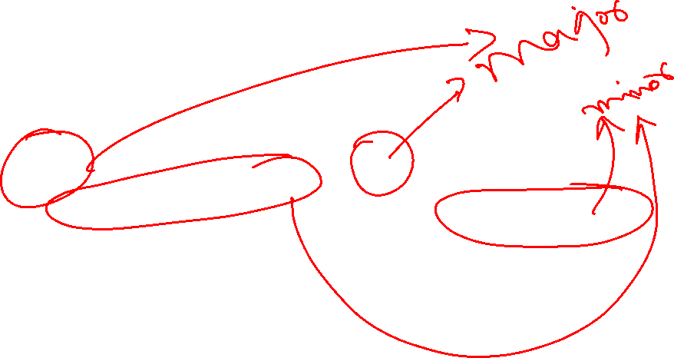
Relationship between objects
Plant Example
Car Example
Plant is composed of leaves and flowers
Flower’s existence depends on the plant.
Car is composed of body, steering wheel, tires, engine etc.
Objects
Plant, Flower, Leaves,
Sunlight
Objects
Car, Body, Steering wheel, tires, engine,
Driver

Slide 7
Relationship type words
How can we identify the relationships between objects?
There are special “relationship type” words to describe these relationships. These are:
part-of
has-a
uses-a
depends-on
member-of
is-a
Can we use these words to describe relationships
we identified?
How are these words useful in context of C++ classes?

Slide 8
Other examples of relationship words
For example:
a square “is-a” shape
a car “has-a” steering wheel
a computer programmer “uses-a” keyboard
a flower “depends-on” a bee for pollination
a student is a “member-of” a class
Your brain exists as “part-of” you
All of these relation types have useful analogies in C++.

Slide 9
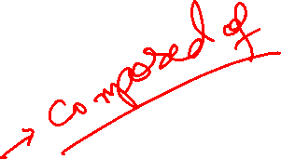
Types of Relationships
Association
Generalization
and
In these two objects are not really related!
Dependency
Realization
Composition
Aggregation
Association

Slide 10
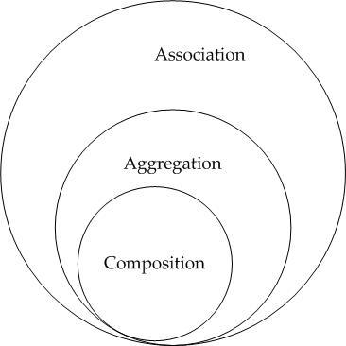
Relationships between Objects
Weak
Strength of relationship
Object
aggregation
Strong

Slide 11
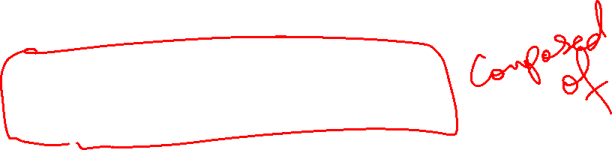
The HAS - A Relationship
Complex objects can be built using simpler ones is called object aggregation
This relationship is described using HAS - A word
Car – engine, steering wheel, frame etc.
Computer – CPU, motherboard, memory etc.
Book – page
Car – Driver
Course – Instructor

Slide 12
The HAS - A Relationship
Complex objects can be built using simpler ones is called object aggregation
This relationship is described using HAS - A phrase
Car – engine, steering wheel, frame etc.
Computer – CPU, motherboard, memory etc.
Book – page
Car – Driver
Course – Instructor
Complex part is called the whole
Simpler object is called the part

Slide 13
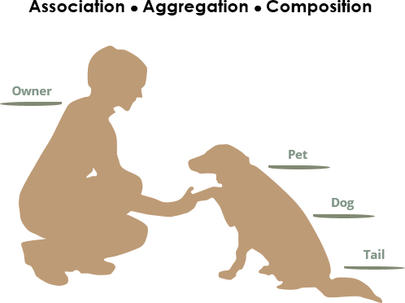

Types of object aggregation
Two types
Composition
Aggregation

Slide 14

Composition
Composition models “part-of” relationships
These relationships are part-whole relationships
Composition is often used to model physical relationships, where one object is physically contained inside another.
Heart is part-of body
Fish are part-of the pond
Circle is composed-of Point / Point is a part-of Circle
Circle
Circle
1
Point
Point

Slide 15
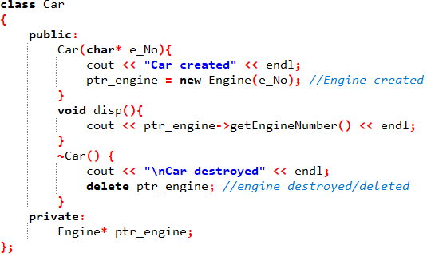

Engine is a part-of Car (Example)
Car
Engine

Slide 16
Engine is a part-of Car (Example)
Car
Engine
Car is composed of Engine, therefore, the creation and destruction of the Engine object is managed by the Car
.
The engine object CANNOT exist without the Car object

Slide 17
//*********Composition Example************
//Accounts are a "PART-OF" the Bank OR
//Bank is "COMPOSED-OF" Accounts
class Account {
double balance;
int accNum;
public:
void open(unsigned int bal) {
balance = bal;
}
int getAccNum() {
return accNum;
}
double getBalance() {
return balance;
}
void close() {
//some closing code
}
};
class Bank {
//Bank is composed of Accounts
Account *accounts;//can also make as Account accounts[100]
int numAccounts;
public:
Bank(int accs=1) {
//creation of Account object(s) controlled by
//Bank object
accounts = new Account[accs];
numAccounts = 0;
}
void OpenAccount(unsigned int openingBalance) {
//Bank object interacts with Account object
accounts[numAccounts].open(openingBalance);
numAccounts++;
}
double getBalance(int accNum) {
//searches an account in the array
for (int i = 0; i < numAccounts; i++) {
//Bank interacts with Accounts to get account
// number and balance
if (accNum == accounts[i].getAccNum())
return accounts[i].getBalance();
}
}
~Bank() {
//destruction of Account object(s) controlled by
//Bank object
//Accounts cannot exist without Bank
delete[] accounts;
}
};

Slide 18
Composition Properties
The whole is composed of the part
i.e. the part object is a data member of the whole class
e.g. the engine object is a data member of the Car class
The part can only belong to one whole at a time
i.e. a part object can only be a data member of a single whole object at one time
e.g. a heart that is part of one Human cannot be a part of another Human at the same time
The part has its existence managed by the whole
i.e. the existence of the part object is controlled by the whole object.
e.g. the creation and destruction of the engine object is managed by the Car object
The part does not know about the existence of the whole – unidirectional
i.e. the part object is a data member of the whole class, the part object knows nothing about the whole class, cannot access its functions
e.g. the engine object cannot call functions of Car class but Car can interact with the engine object

Slide 19
Composition
Why create a so many classes instead of direct implementation in just a single class?
Car (whole) Engine (part) example
Composition
Each individual class should be focused on performing one task (simple and straight forward)
Each class can be self-contained, which makes them reusable.
The composing class can focus only on coordinating the data flow between the composed classes.
Address
Employee
PerformanceHistory
Circle
Point

Slide 20
Composition
Break down into simpler classes or directly implement everything in one class?
One class one task
Address
Employee
PerformanceHistory

Slide 21
Composition
Break down into simpler classes or directly implement everything in one class?
One class one task
Address
Employee
PerformanceHistory

Slide 22
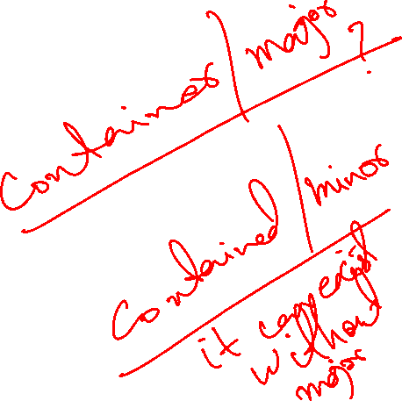
Aggregation
An aggregation is also a part-whole relationship
It models HAS-A relationship
Similarities to composition
The parts are contained within the whole
It is also a unidirectional relationship
Unlike composition
Whole is not responsible for the existence and lifespan of the parts
Parts can belong to more than one object at a time

Slide 23
Aggregation
Address
Person
Singular part
Multiplicative parts
Every person has an address.
One address can belong to more than one person at a time
Address existed before the person starting living at the address
Whole knows of existence (person knows)
Part doesn’t know about the whole
A address is part of the person.
Address belongs to a Person,
The same address can belong to other people as well.
The Person is not responsible for the creation or destruction of the address.
Whole knows about existence
Part doesn’t know about the whole

Slide 24
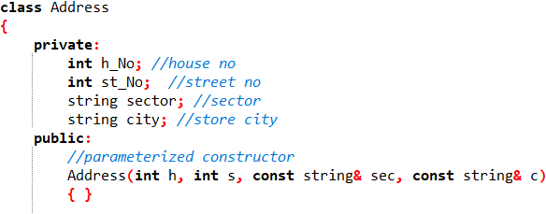
Person has an Address - Example

Slide 25
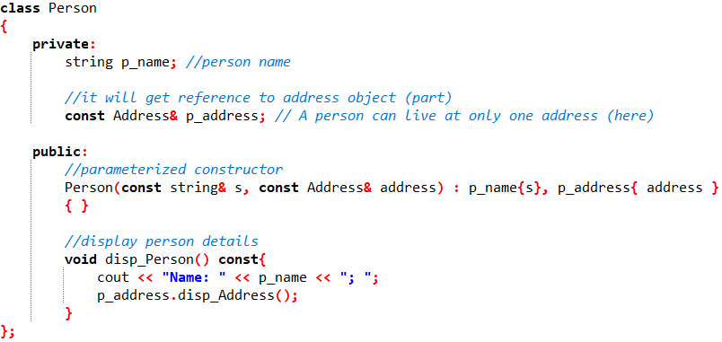
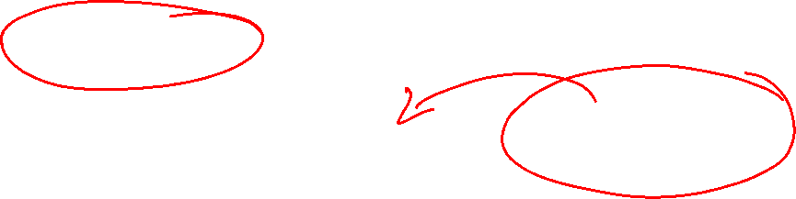
Person has an Address - Example

Slide 26
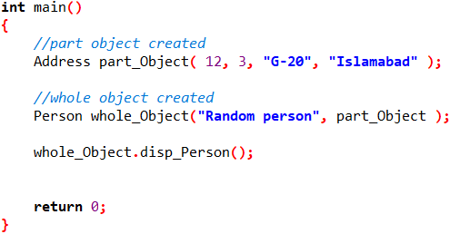

Person has an Address - Example

Slide 27
//*********Aggregation Example************
//Person is "HAS-A" Address
class Address {
int h_num;
int st_num;
string sector;
string city;
public:
Address(int hnum, int stnum,const string&sector,const string&city) {
cout << "\n Address Constructor called" << endl;
h_num = hnum;
st_num = stnum;
this->sector = sector;
this->city = city;
}
void display() const{
cout << "House # " << h_num << ", Street # " << st_num
<< ", Sector " << sector << " City " << city << endl;
}
~Address() {
cout << "\n Address Destructor called" << endl;
}
};

Slide 28
class Person {
string name;
//const to prevent changes
const Address& add; //can also do Address *add;
public:
Person(const string&name,const Address &address):add(address) {
//initializer list used because const reference
this->name = name;
cout << "\n Person Constructor called" << endl;
}
void displayPerson() const {
cout << "Name: " << name << endl << "Address ";
add.display();
}
~Person() {
cout << "\n Person Destructor called" << endl;
} };
int main()
{ Address a1(20, 16, "Some Sector", "Some City");
{ Person p1("SomeName", a1); //created in this scope
p1.displayPerson();
//Person p1 destroyed here, a1 still exists
}
a1.display();
return 0;
}

Slide 29
Aggregation Properties
The part is part of the whole
i.e. the part object is a data member of the whole class
e.g. a Patient object is a data member of the Doctor class
The part can belong to more than one wholes at a time
i.e. the part object can be a data member of multiple whole objects
e.g. a single Patient object can be a part of multiple doctor objects
The part does not have its existence managed by the whole
i.e. the creation and destruction of the part is not done by the whole
e.g. the doctor will not create or destroy patient objects
The part does not know about the existence of the whole

Slide 30
Implementing aggregation VS composition
Aggregation
Parts are added as references or pointers
Whole is not responsible for creation and deletion
Whole takes the objects it is going to point to as:
1) constructor parameters;
2) parts are added later via access functions like setters
Parts exists outside the scope of whole
Composition
Parts are added as normal variables (or pointers)
Whole is responsible for creation and deletion

Slide 31
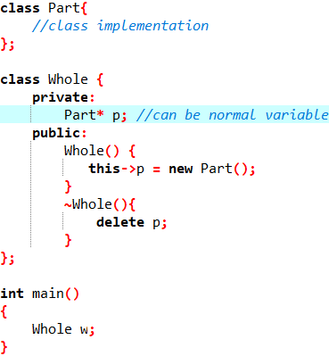
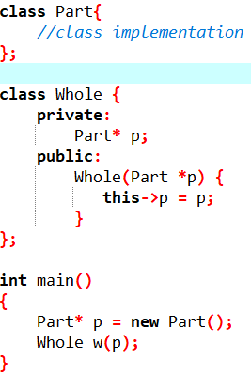

Examples
Composition
Aggregation
Creation done in side whole

Slide 32
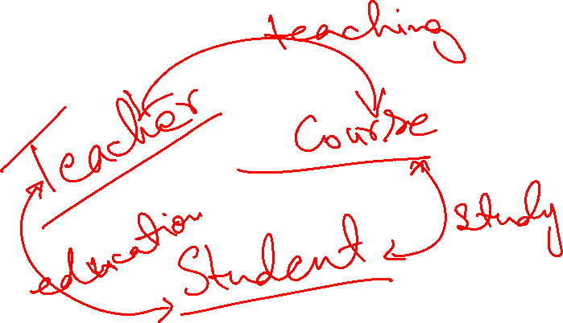
Association
A weak of relationship
Two otherwise unrelated objects
There is no implied whole/part relationship
Models a uses - a relationship

Slide 33
Association
Composition | Aggregation | Association
Whole/Part relationship | Whole/Part relationship | Associated object is unrelated
Associated object can belong to only one object | Associated object can belong to multiple objects | Associated object can belong to multiple objects
Unidirectional | Unidirectional | Usually Bidirectional

Slide 34
Association
Student
Faculty
Bus
Student
The teacher clearly has a relationship with his students and vice versa
It’s not a part/whole (object composition) relationship
A teacher can teach many students
A student can study from many teachers
Neither of the object’s lifespans are tied to the other.
Bidirectional
A student has a relationship with the route bus
Its not a part/whole relationship
Multiple students can be on a certain route
Neither of the object’s lifespans are tied to the other
Bidirectional

Slide 35
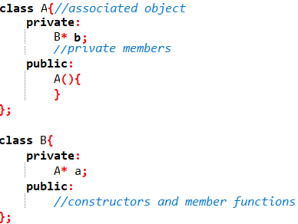
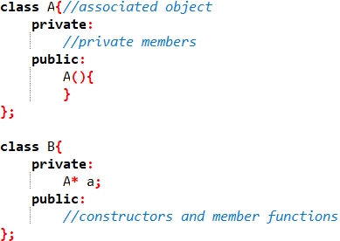
Implementing Association
Associations are a broad type of relationship
They can be implemented in many different ways
Association implemented using pointers

Slide 36
Composition vs Aggregation vs Association
Property | Composition | Aggregation | Association
Relationship type | Whole/part | Whole/part | Otherwise unrelated
Members can belong to multiple classes | No | Yes | Yes
Members existence managed by class | Yes | No | No
Directionality | Unidirectional | Unidirectional | Unidirectional or bidirectional
Relationship verb | Part-of | Has-a | Uses-a
Engine
Car
Address
Person
Bus
Student
Student
Faculty

